Slide 1



Smart Agriculture System Using IoT
Submitted By:
Vatsal Gupta

Slide 2
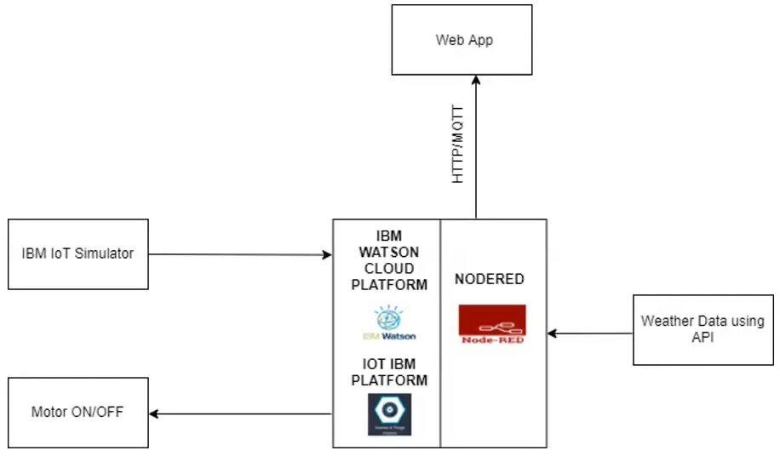
Block Diagram

Slide 3

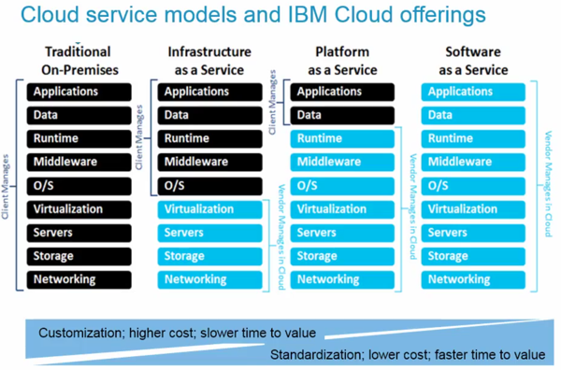
IBM Cloud

Slide 4
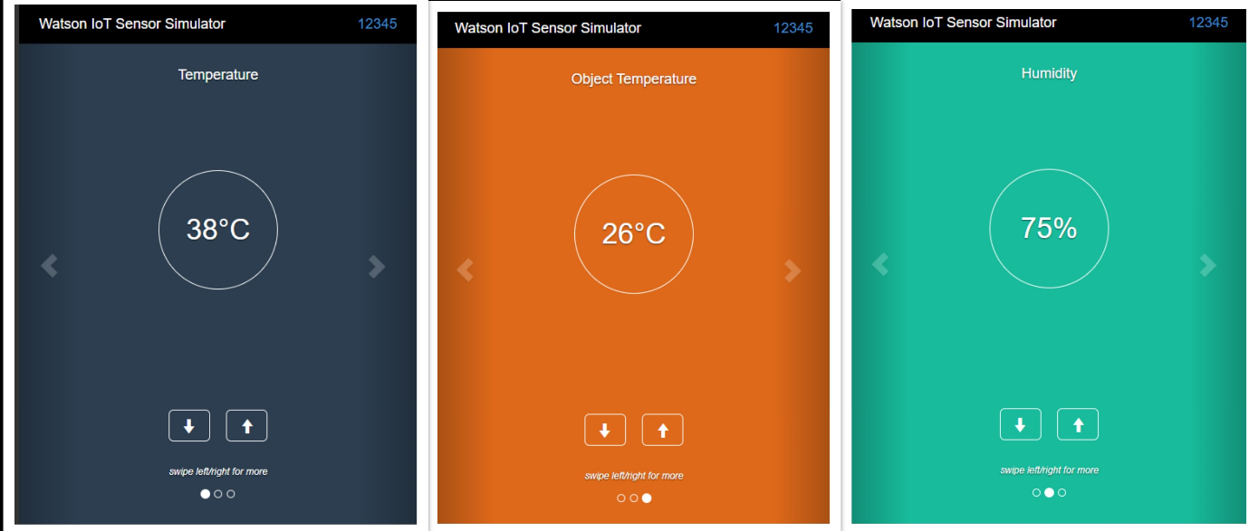
IBM IoT Simulator

Slide 5
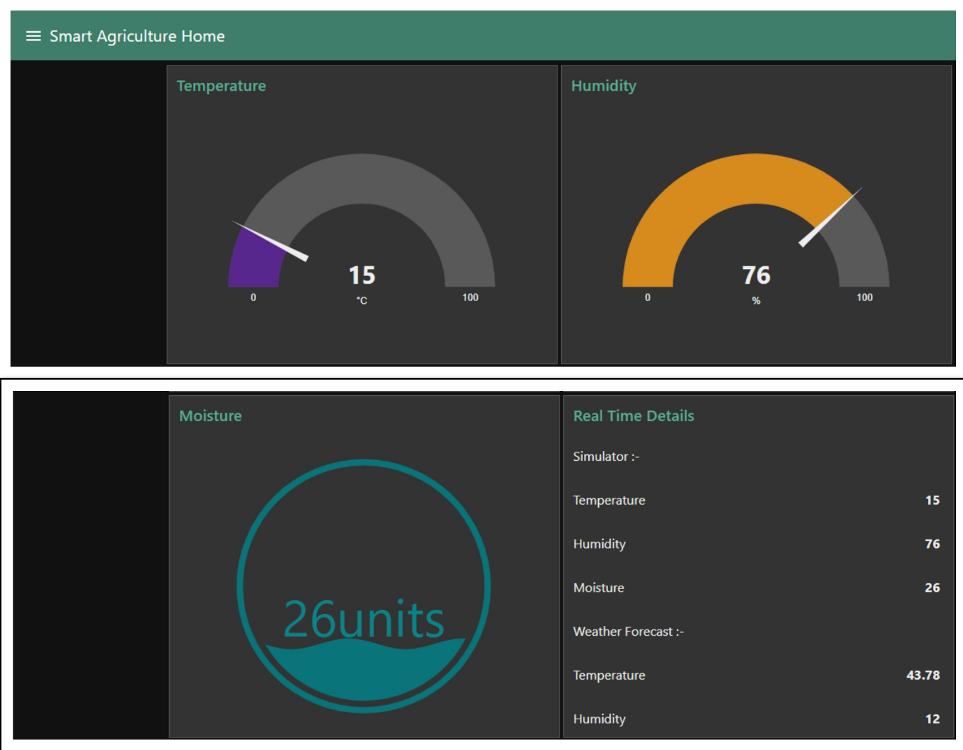
Node-red UI

